Slide 1
Considerations for the Engineering and Design of Aboveground Storage Tanks
Richard B. Garrett, PE
March 2, 2011

Slide 2
Issues covered in this Presentation:
Considerations for determining size of tank desired.
Owner’s perspective of what information should be conveyed to tank design team.
Comparison of Geodesic Dome vs. Cone Roof tanks.
Issues to consider per NFPA 30.
Miscellaneous Safety considerations.
Maintenance considerations.
Options for foundation design.
Check Requirements – State Web Page

Slide 3
Establish product, whether or not Internal Floating Roof will be used and type / dimensions of IFR
Determine Desired Working Volume:
Daily Throughput x (Resupply Interval + Safety Factor)
10,000 bbl/day, 7 day resupply, 3 day safety stock
Minimum Working Volume = 100,000 bbl

Slide 4
Highest impact to available capacity is Internal Floating Roof
Overfill or Damage level
(Approx. 3’ from top of tank)
High – High Alarm
High Level Alarm
Normal Fill
Distance between levels is based on maximum fill rate x response time (usually 5 minutes or 6” minimum)
Bottom of tank minimum level depends on floating suction geometry to keep liquid from falling below roof for emissions. Normally set around 3’ - 4’.
Expect to lose about 7’ – 8’ total height from volume with IFR.

Slide 7
External Roof
Cone Roof vs. Geodesic Dome Roof
Design Considerations – perimeter railing vs. perimeter wind girder designed for access to inspection ports.
Maintenance of coating, vs. panel seams
Overall Cost Comparison
Overall Height – no real limitations, guided mainly by:
Local codes, zoning restrictions on height limitations
Consider available water pressure height to fight fires
Aesthetics compared with other tanks
Managing tank alignment if more than one live at same time
Consider Operators – if over 60’, may need intermediate landing

Slide 8
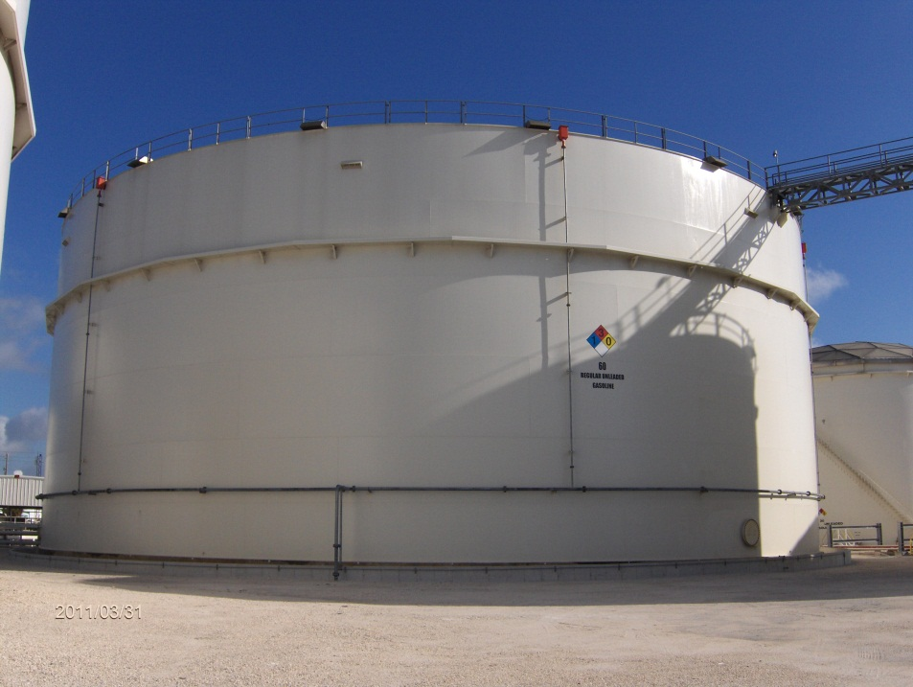
Geodesic Dome vs. Cone Roof
48’ Geodome with perimeter walk/girder
56’ High Cone with perimeter railing

Slide 9
Net Positive Suction Head Required
NPSHR – compare greater of NPSHR, tank outlet, floating suction, bottom of tank roof to determine minimum tank level.
Remember to take into account all losses from the point of suction to the pump inlet. This is especially critical if using a floating suction for product quality. Depending on the geometry of the swivel, you could experience more loss through that one item than the whole length of piping.

Slide 10
Random Design / Safety Issues
Emissions options – even though IFR may not be required for Distillate (Jet, Diesel, Kerosene), including this control measure will reduce calculated emissions and may keep you from needing a Title 5 permit.
Tank stairs are laid out for convenience, usually along the normal operator walk path. However, from a safety standpoint, tank stairs or walkways providing tank top access should not cross tank valves.
As indicated in previous presentations, incorporating a corrosion allowance for bottom and shell, especially if prior experience shows potential areas of corrosion in similar service tanks, can pay big dividends down the road.
Tank Anchoring may be required for not only earthquake areas, but also due to high wind (hurricanes), especially with diameter to height ratio less than 1.5.
For product quality and to facilitate removal of water, consider using single sloped bottom with deep sump.

Slide 11
Fire Protection - NFPA
Fire Protection – As mentioned in previous presentations, NFPA sets minimum requirements that local AHJ can increase at their discretion. For example, Section 22.8.2 states that “…floating roof tanks containing any liquid shall not require protection when installed in accordance with this chapter.” However some local departments still require foam protection for these type of tanks.
Note – Requirements of Chapter 22 either require remote impoundment, intermediate diking, or other engineered option.
Spacing is essentially 1/6 sum of diameters of adjoining tanks, up to 150’ diameter. Larger diameter may require increase to 1/4 sum of diameters.
If required, you might want to consider the use of underground HDPE for transmission lines. Alternative usually requires application of sprinkler code, which requires supports at 15’ on center, designed to support 5 x the weight of the lines plus 150 lbs.

Slide 12
Coatings
Many municipalities now require blast media to be collected and properly disposed of. On site, this can be difficult and costly. One option would be to have shell plate primed before shipping and installation.
Bottom is likely to contact with water, consider good thin film coating to extend life.
Depending on product service, may want to coat inside of tank – ie:
Ethanol – potential corrosive stress cracking
Avgas – tends to be more corrosive than other finished products.
The best intentions mean nothing – a key quality control measure is Coating Inspections – especially in smaller facilities. Bring in early to have input into specification, such as surface preparation, maximum humidity allowed, admixtures for holding blast, recoat window, etc.

Slide 13
Foundation Alternatives
Excavate & replace unsuitable soils
Piles –
Driven to refusal, can disturb nearby structure
Auger cast – less disturbance
Both still require pile caps to transmit load from bottom to pilings.
Soil Stabilization –
Low disturbance to nearby structures
Reduces waste removal
With proper testing and documentation, binder material can serve as remediation

Slide 14
Check for Requirements

Slide 16
Questions?
Richard B. Garrett
rick0702@msn.com

